Slide 1

Project 1
Metro Nashville & Davidson county
Traffic crashes 2018
Team 1
Charlie Coffey - Michele Bowman - Mohammad Qreyeah - Zachary Nguyen

Slide 2
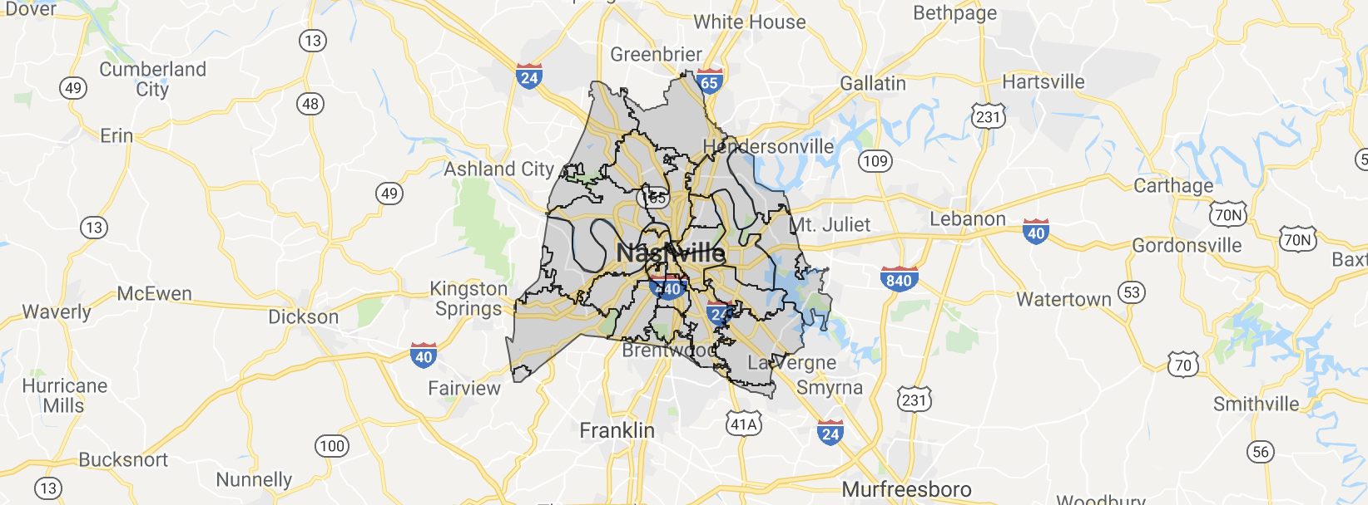
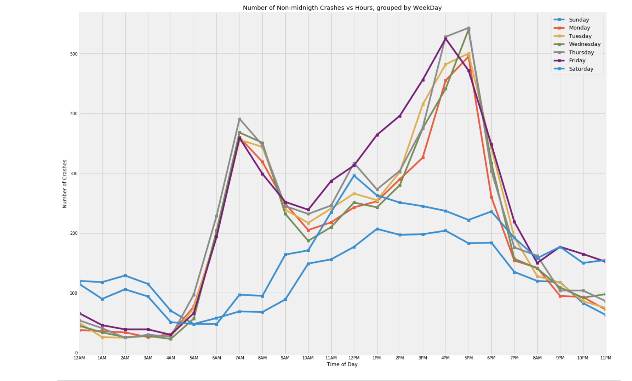
Outline
1. Crashes vs. Location
Plot all reported accidents in Davidson County
Heat map of all reported accidents in Davidson County, grouped by Zip-code Areas
2. Crashes vs. Time
Number of all accidents vs Hours
Number of all accidents vs Weekdays
Hypothesis: whether or not our observed frequencies of traffic
accidents occur equally frequently for the different weekdays

Slide 3
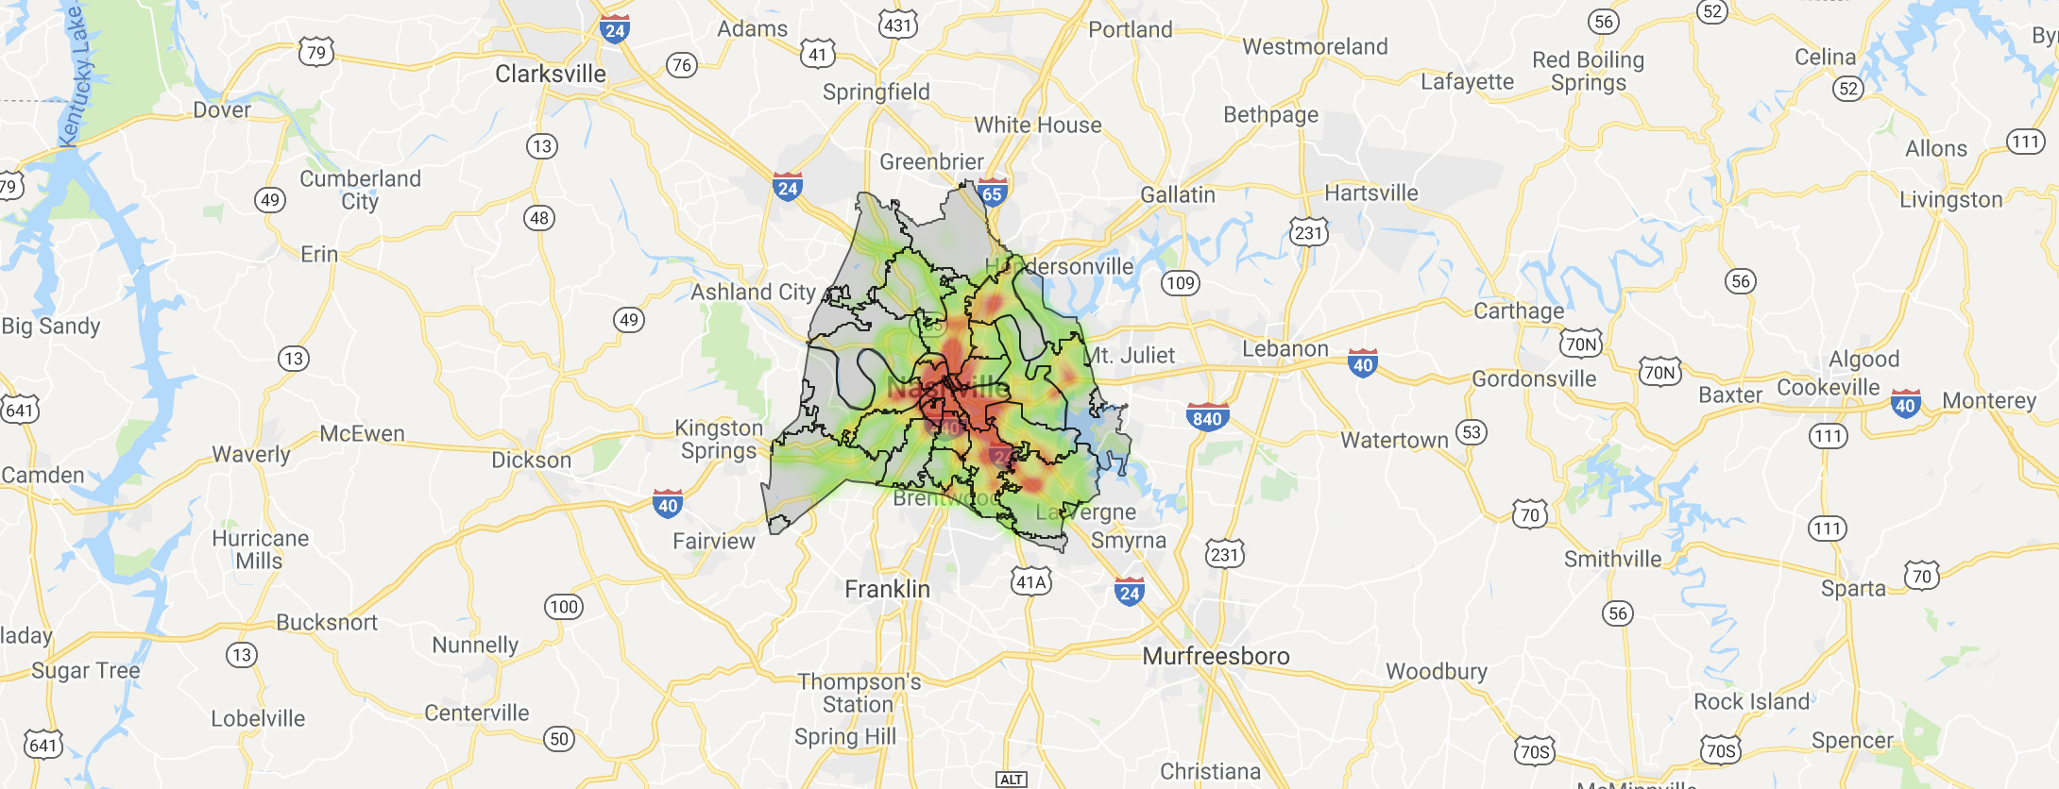

Outline
1. Crashes vs. Location
Plot all reported accidents in Davidson County
Heat map of all reported accidents in Davidson County, grouped by Zip-code Areas
2. Crashes vs. Time
Number of all accidents vs Hours
Number of all accidents vs Weekdays
Hypothesis: whether or not our observed frequencies of traffic
accidents occur equally frequently for the different weekdays

Slide 4




Data.Nashville.Gov
31.2K rows dataset (.csv) provides details about traffic crashes that occur in Davidson County
Shape-file (.geojson) indicating the boundaries of Zip Code areas of Davidson County
GOOGLE API
Gmaps library to visualize and interact with geographical data.
Jupyter Notebook & Python Libraries
Pandas
NumPy
Matplotlib
Json
Gmaps
Scipy.stats
DATA SOURCES & TOOLS

Slide 5
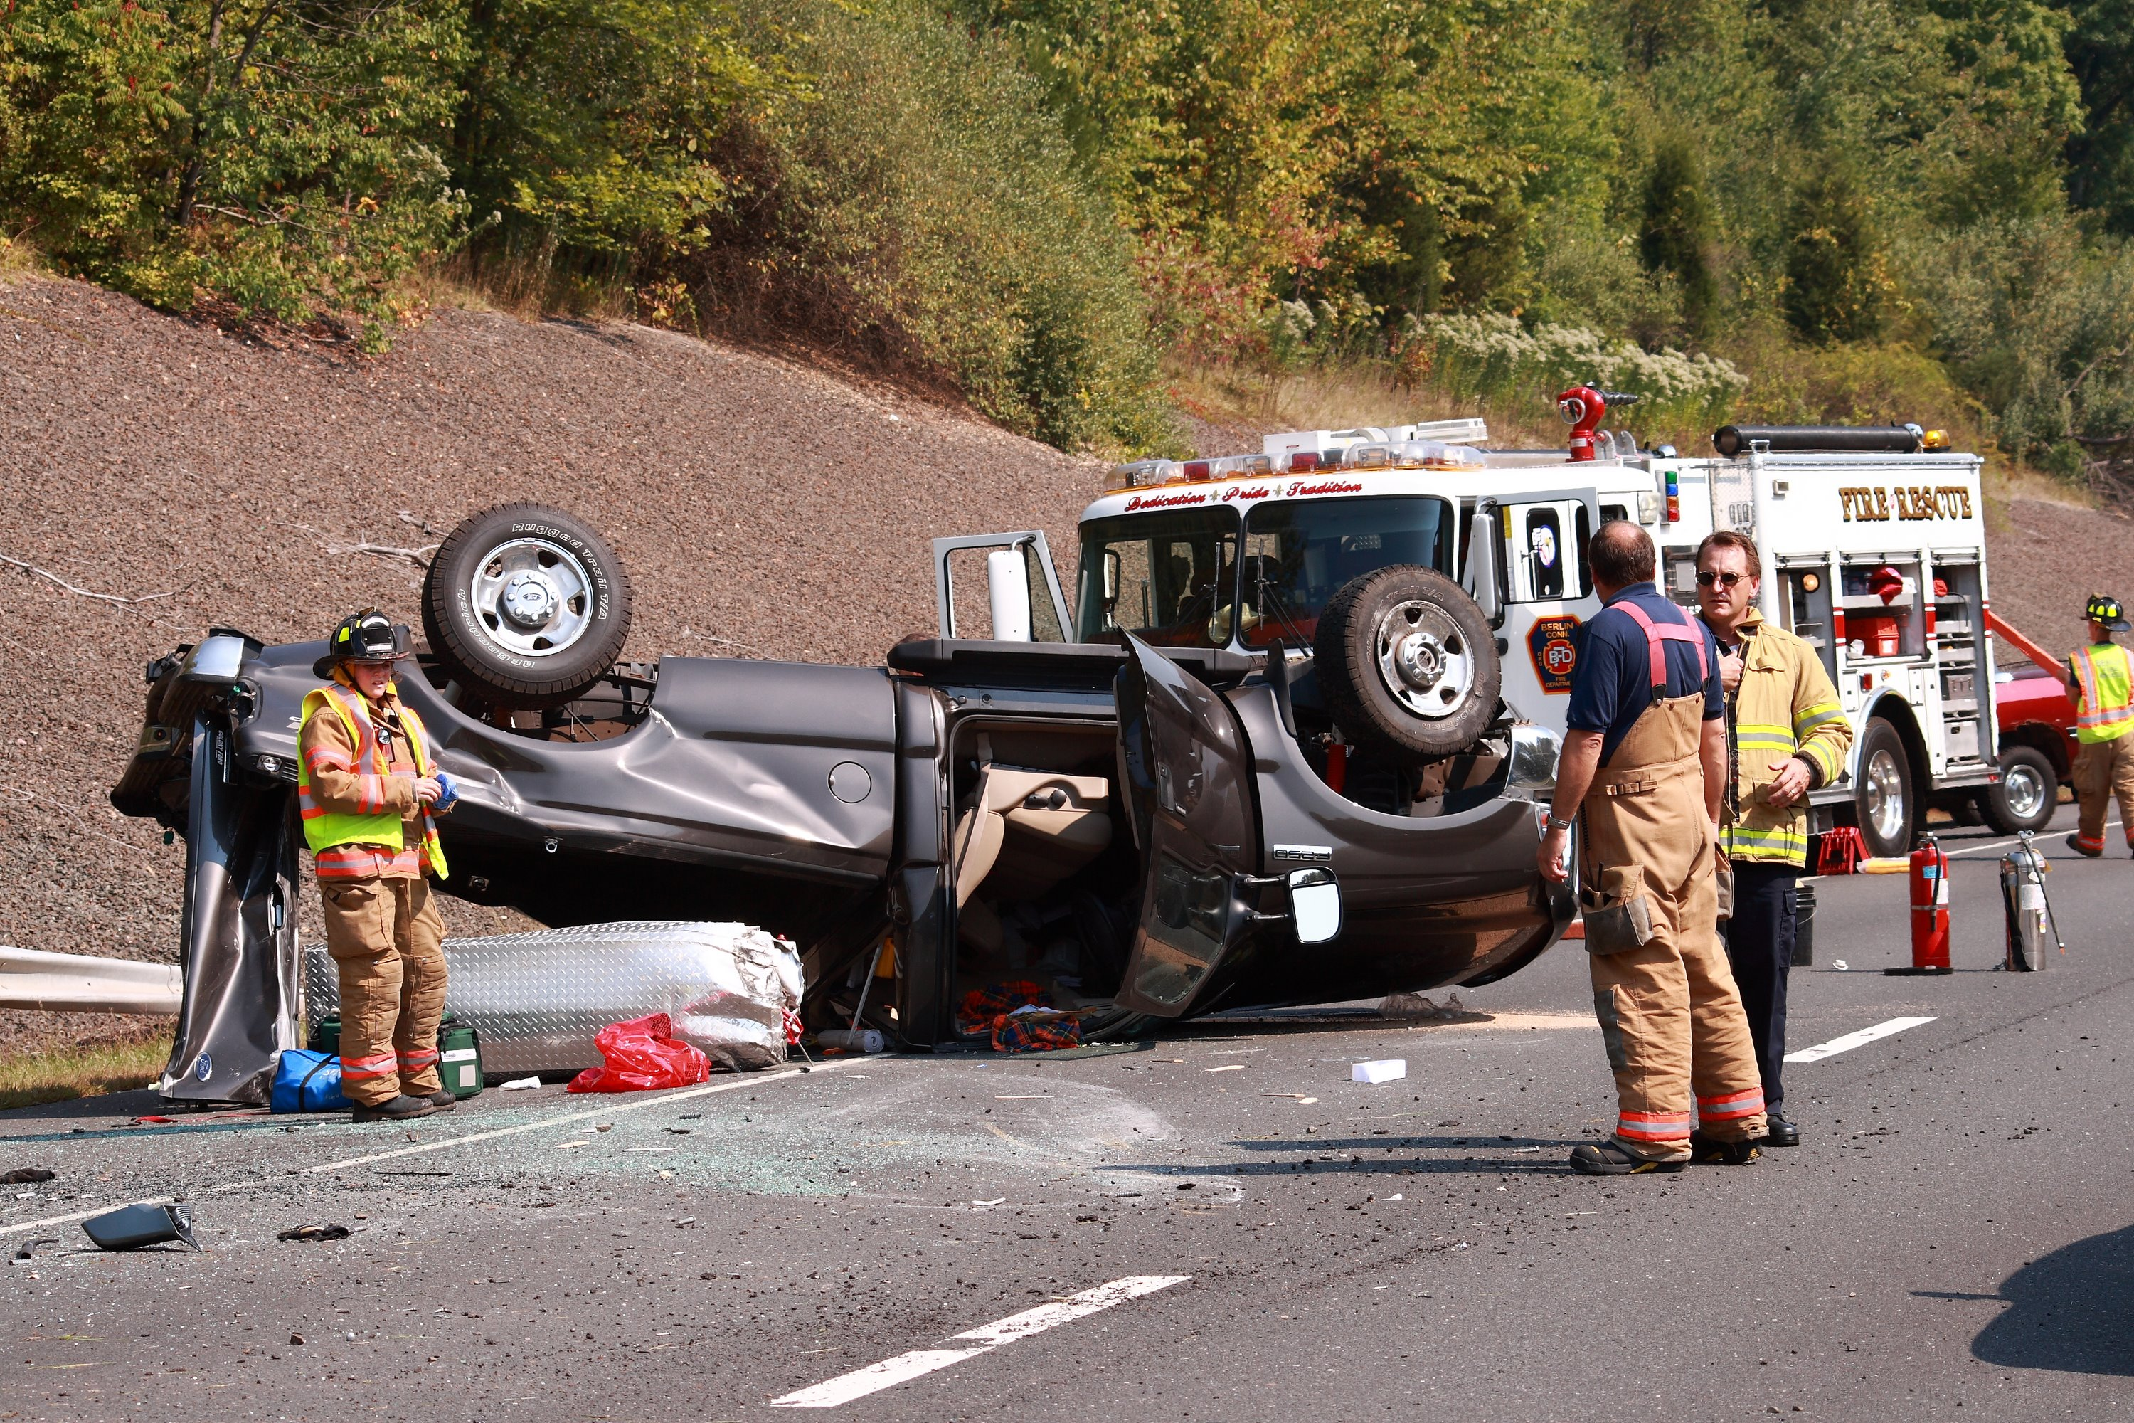
Part 1
Number crashes VS. location
Where do you believe the most crashes happen?
Downtown
Antioch
South Nashville
Cumberland Heights

Slide 6
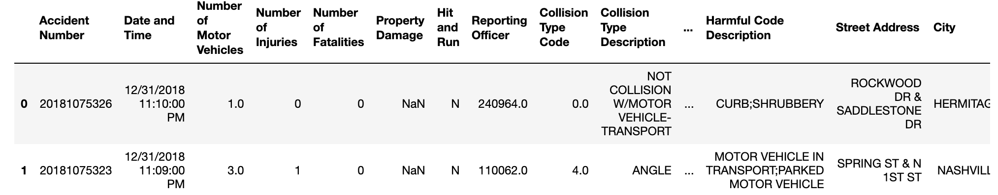
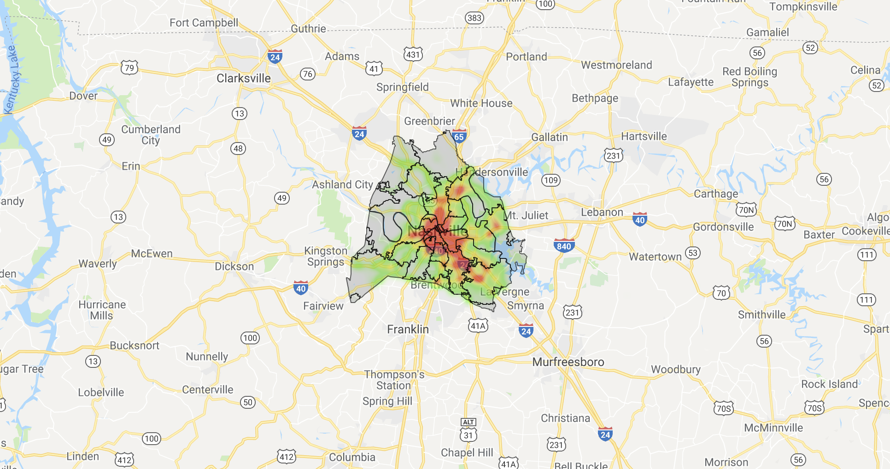
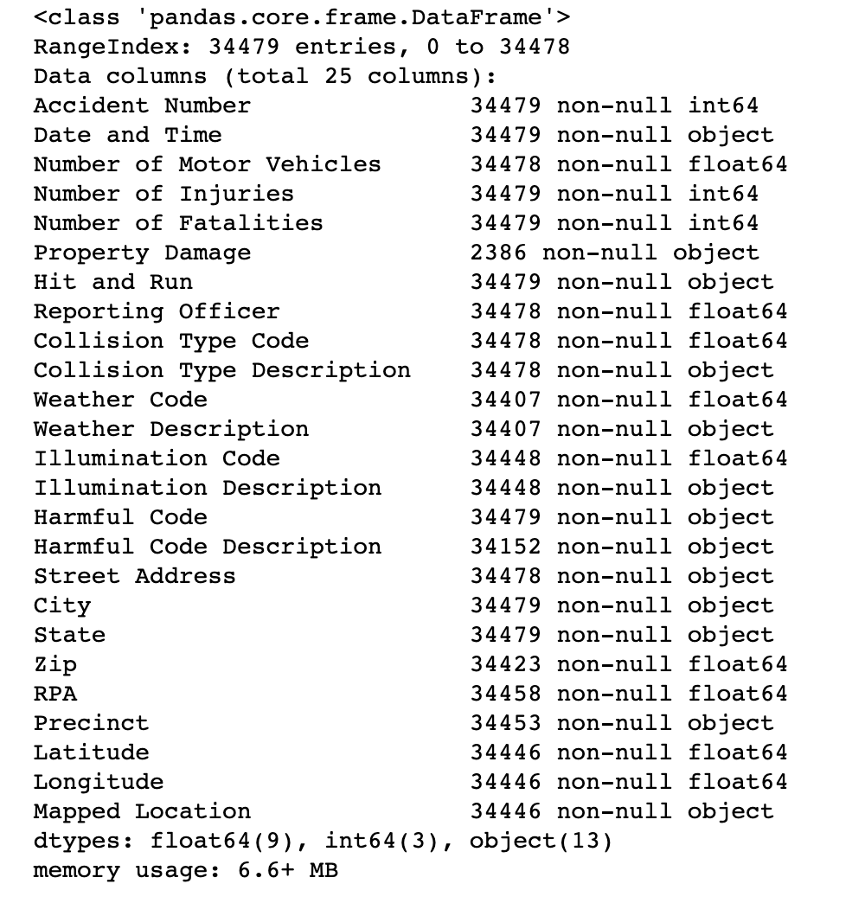
Part 1: crashes vs. location
Analysis 1- Plot all reported accidents in Davidson County with gmaps
Import CSV file into Dataframe
Removing any rows with NULL values in Latitude OR Longitude columns
df=pd.read_csv("../Metro_Nashville_Davidson_County_Traffic_Crashes_2018_.csv"
filtered_df=df[((df.Latitude.notnull())|(df.Longitude.notnull()))]
{DataFrame:34446,25}
import gmaps
gmaps.configure(api_key=‘AIz…’)
…
import json
with open('../Data_Sources/Davidson.geojson') as f:
zip_geo_json = json.load(f)
…
fig.add_layer(gmaps.heatmap_layer(filtered_df[['Latitude','Longitude']]))

Slide 7
Part 1: crashes vs. location
Analysis 1 - all reported accidents in Davidson County with gmaps
Most of car accidents (red dots) was happened on Highways: I24, I65, I40, I440

Slide 8
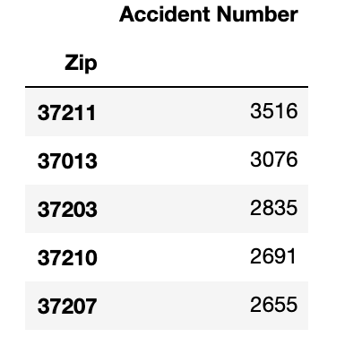
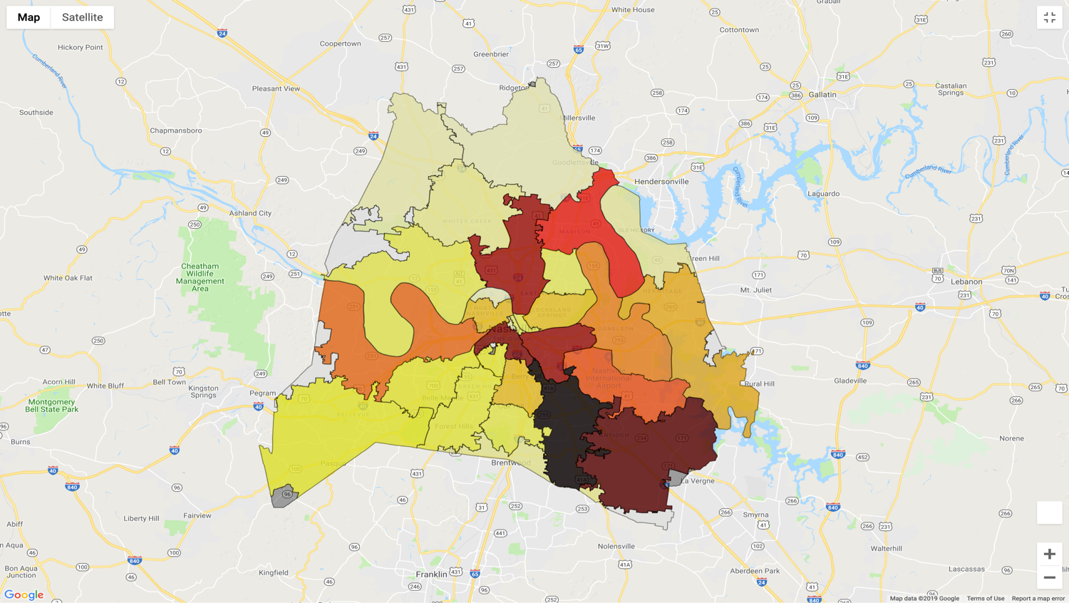
Part 1: crashes vs. location (cont.)
Analysis 2-heat map of all reported accidents in Davidson County, grouped by Zip-code Areas
Number of car accidents in each Zip-code area
zip_crashes=filtered_df.groupby(['Zip']).agg({"Accident Number":"count"})
Plotting the heat map
fig = gmaps.figure()
crash_layer = gmaps.geojson_layer(
zip_geo_json,
fill_color=colors,
stroke_color=colors,
fill_opacity=0.8)
fig.add_layer(crash_layer)
# border
fig.add_layer(gmaps.geojson_layer(zip_geo_json,fill_opacity=0.05))

Slide 9
PART 2: crashes vs. time
Analysis 1 - Crashes vs. hours
What time of day do you believe the most crashes happen?
12 A.M
7 A.M
3 P.M
5 P.M

Slide 10
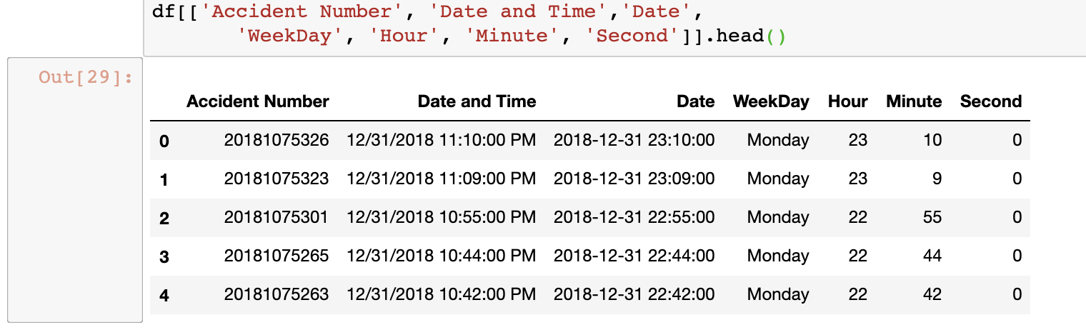
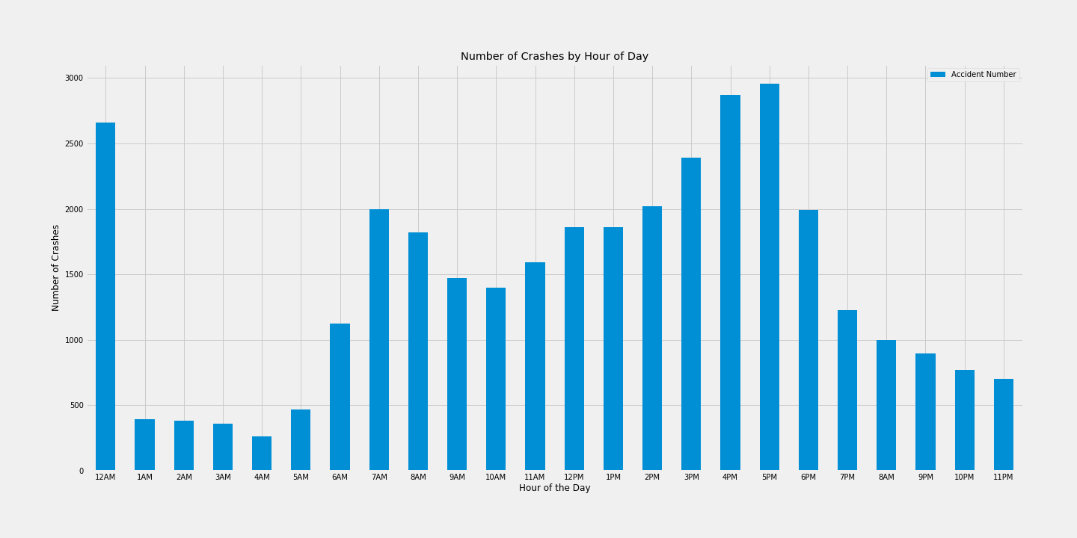
pART 2: crashes vs. time
Analysis 1 - Number of All reported crashes by 24 Hours
Data manipulation: Add columns of detailed Time info (from "Date and Time" column)
df['Date']=pd.to_datetime(df['Date and Time'])
df['WeekDay']=df.Date.dt.weekday_name
df['Hour']=df.Date.dt.hour
df['Minute']=df.Date.dt.minute
df['Second']=df.Date.dt.second
Number of car accidents grouped by Hours
hour_crashes=df.groupby(['Hour']).agg({"Accident Number":"count"})
Bar Graph
# Plotting
hour_crashes.plot(kind='bar',figsize=(20,10))
plt.title("Number of Crashes by Hour of Day")
plt.xlabel("Hour of the Day")
plt.ylabel("Number of Crashes")
plt.xticks(np.arange(0,24,step=1),
('12AM','1AM',‘2AM','3AM','4AM','5AM','6AM','7AM','8AM','9AM','10AM','11AM','12PM',‘1PM','2PM','3PM','4PM','5PM','6PM','7PM','8AM','9PM','10PM','11PM'),rotation=0)
plt.savefig("Number of Crashes by Hour of Day - All")
plt.show()

Slide 11
pART 2: crashes vs. time
Analysis 1 - Number of All reported crashes by 24 Hours
Note:
The number of all reported crashes by hour of day in Davidson County is likely related to the traffic hour.
More accidents occurred at rush-hour ranges: 7:00-9:00 A.M. and 4:00-6:00P.M.
There was an abnormal data in this plot at the range of 12:00-1:00 A.M where the number of crashes was relatively high compared with its neighbor ranges (i.e., 11:00 P.M. -12:00:00 A.M and 1:00 - 2:00 A.M.)
Car accidents with unknown time were automatically assigned as exact the midnight (i.e., 12:00:00 A.M.)
We need to identify and handle those unknown-time data properly.
12 A.M
7 A.M
3 P.M
5 P.M

Slide 12

pART 2: crashes vs. time
Analysis 1 - Number of All reported crashes by 24 Hours
Fig1: Including unknown-timed accidents
Fig2: Separation of unknown-timed accidents
12 A.M
7 A.M
3 P.M
5 P.M
midnight_df=df[(df.Hour == 0)&(df.Minute==0)&(df.Second==0)]
notmidnight_df=df[(df.Hour != 0)|(df.Minute!=0)|(df.Second!=0)]
2,169 rows from the data frame with a time of 12:00 AM, as police officers use this time if the exact time of the accident is unknown

Slide 13
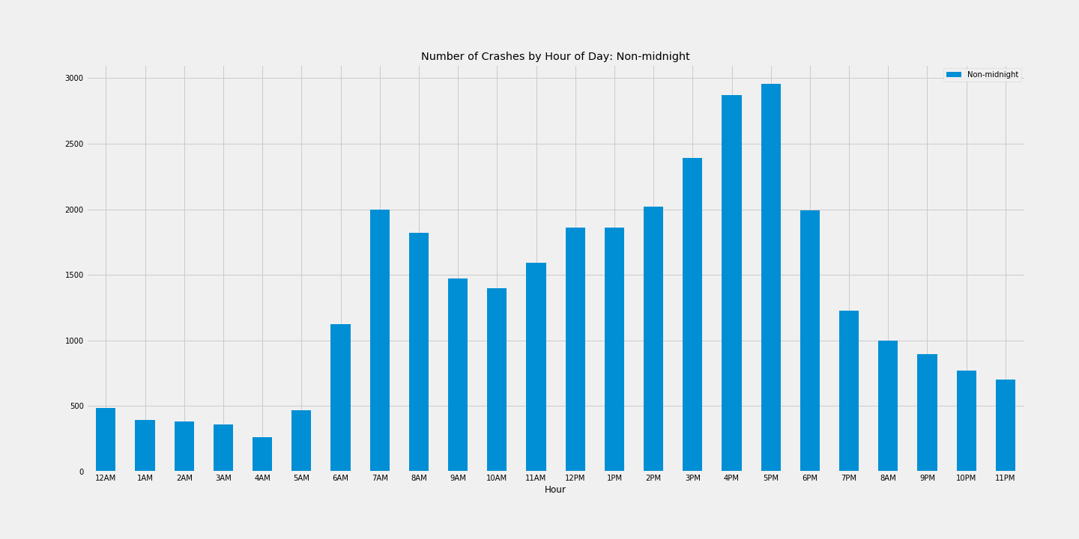
pART 2: crashes vs. time
Analysis 1 - Number of All reported crashes by 24 Hours
Note:
After those unknown-time data were separated and removed properly, the final data now looks more reasonable!
12 A.M
7 A.M
3 P.M
5 P.M

Slide 14
PART 2: crashes vs. time
Analysis 2 - Crashes vs. Weekdays
What day of the week do you believe the most crashes happen?
Monday
Thursday
Friday
Saturday

Slide 15
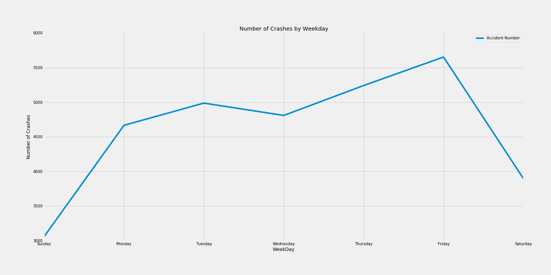
pART 2: crashes vs. time
Analysis 2 - Number of All reported crashes by Weekdays
Number of car accidents grouped by Hours
cats = ['Sunday','Monday', 'Tuesday', 'Wednesday', 'Thursday', 'Friday', ‘Saturday']
wdcs=notmidnight_df.groupby([‘WeekDay']).agg({"Accident Number":"count"}).reindex(cats)
Line Graph
wdcs.plot(kind=‘line',figsize=(20,10),rot=0)
plt.ylim(3000,6000)
plt.title("Number of Crashes by Weekday")
plt.ylabel("Number of Crashes")
plt.margins(3)
plt.savefig("Number of Crashes by Weekday")
plt.show()
Question:
Whether or not do our reported frequencies of traffic accidents occur equally frequently for the different weekdays?

Slide 16
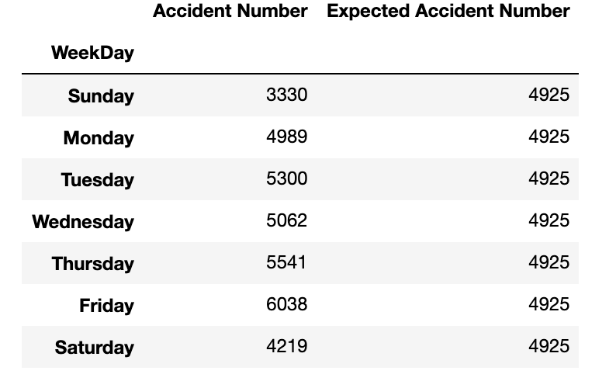
pART 2: crashes vs. time
Analysis 2 - Number of All reported crashes by Weekdays: Statistics-Chi Square Test
Chi-Square test:
Chi-square is used to test hypotheses about the distribution of observations in different categories.
The larger the value of χ², the more likely it is that the distributions are significantly different.
$${\overset{˜}{χ}}^{2}=\overset{n}{\underset{k=1}{∑}}\frac{(O_{k}-E_{k})^{2}}{E_{k}}$$
Null Hypotheses:
The frequencies of traffic accidents occur equally frequently for the different weekdays
Creation of expected data:
Calculation of the standard normal distribution for the probability 0.95
wdcs['Expected Accident Number'] = int(wdcs[“Accident Number"].sum()/7)
# The statistical module used to run chi square test
import scipy.stats as stats
# With a p-value of 0.05, the confidence level is 1.00-0.05 = 0.95.
critical_value = stats.chi2.ppf(q = 0.95, df = weekday_crashes.shape[0])
critical_value
14.067140449340169
Run the chi square test with stats.chisquare()
stats.chisquare(wdcs["Accident Number”],wdcs['Expected Accident Number'])
Power_divergenceResult(statistic = 979.5281218274112,
pvalue. = 2.3926998428223567e-208)
Comparison:
statistic = 979.5281218274112 > critical_value = 14.067140449340169
We can therefore be relatively confident in concluding that our observed frequencies are significantly different from the frequencies that we would expect to obtain if all categories were equally distributed. In other words, weekday is related to the amount of road traffic accidents that occur.

Slide 17
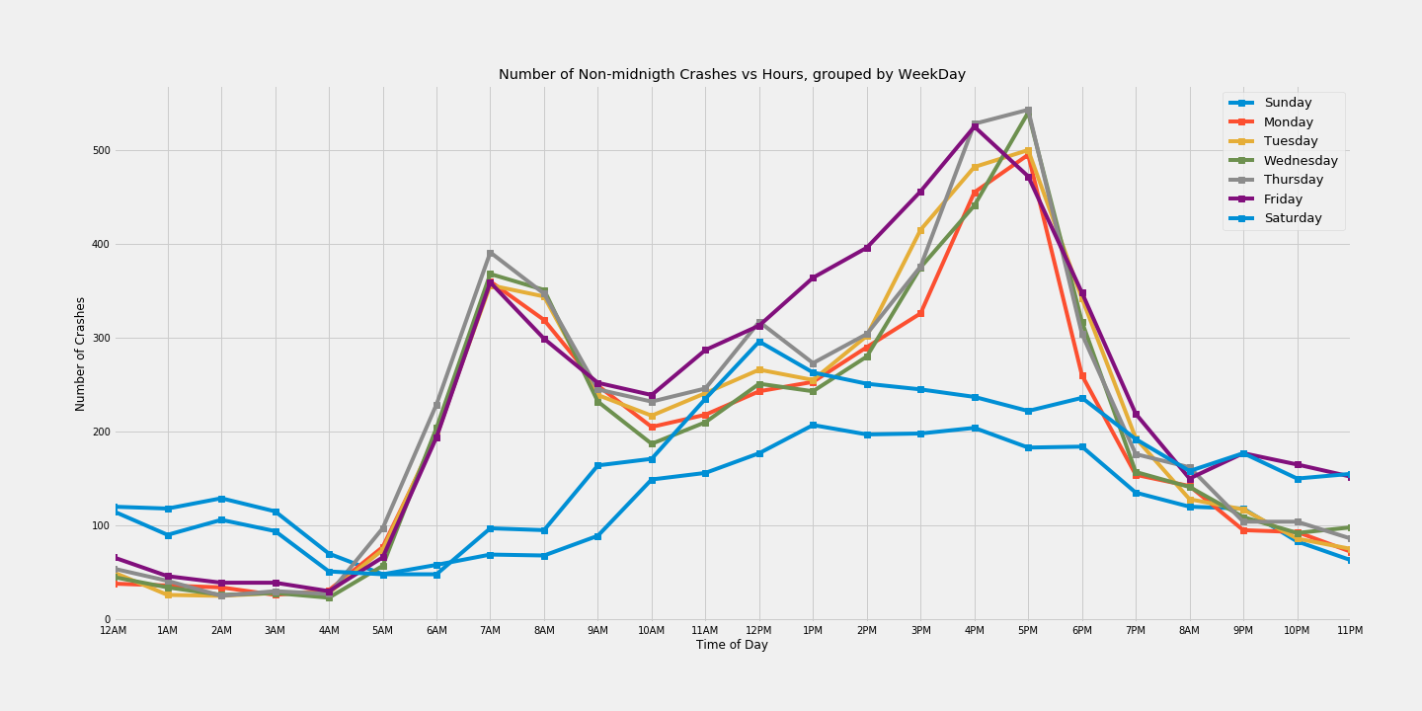
pART 2: crashes vs. time
Analysis 3 - Number of All reported crashes vs. Weekdays by time of Day
Number of car accidents grouped by Weekdays & Hour
wdhour_crashes=notmidnight_df.groupby(['WeekDay','Hour']).agg({"Accident Number”:”count"})
wdhour_crashes=wdhour_crashes.reset_index()
pivot_wdhour_crashes=wdhour_crashes.pivot(index='Hour',columns='WeekDay',values='Accident Number’)
cats = ['Sunday','Monday', 'Tuesday', 'Wednesday', 'Thursday', 'Friday', 'Saturday']
pivot_wdhour_crashes=pivot_wdhour_crashes[cats]
Line Graph
pivot_wdhour_crashes.plot(figsize=(20,10),marker='s')
plt.title("Number of Non-midnigth Crashes vs Hours, grouped by WeekDay")
plt.xlabel("Time of Day")
plt.ylabel("Number of Crashes")
plt.xticks(np.arange(0,24,step=1),('12AM', '1AM', '2AM','3AM','4AM','5AM','6AM','7AM','8AM','9AM','10AM','11AM',
'12PM', '1PM', '2PM','3PM','4PM','5PM','6PM','7PM','8AM','9PM','10PM','11PM'))
plt.legend(loc='best', prop={'size': 13})
plt.savefig("Number of Crashes VS Hour By Weekday")
plt.show()

Slide 18
The majority of accidents are clustered in the metro Nashville area and are less widespread as you leave the downtown radius. The exception is leaving Nashville going Eastbound/Westbound on I-24.
Top 5 of Zip-code areas have the highest number of of accidents are: 37211, 37013, 37203, 37210, 37207
The highest number of accidents occurred on Friday.
The lowest number of accidents occurred on Sunday.
The highest number of accidents occurred on Thursday at 5:00pm.
The lowest number of accidents occurred on Monday at 12:00am (midnight).
The data showed a peak at 7:00am of accidents on Monday-Friday.
The data showed a peak at 5:00pm of accidents on Monday-Thursday and a peak of accidents at 4:00pm on Friday.
This project was completed by using pandas, numpy, matplotlib, json, spicy.stats & gmaps with Gmaps API
SUMMARY

Slide 19
1
3
Census Data:
We could use the US Census API for population by zip code in Davidson County to determine if more accidents occurred in areas with a larger population.
Open Weather:
We could use Open Weather API to see if there was any correlation between weather and accidents
2
Census Data:
We could used the US Census API data to review the total population change from 2008 vs. 2018 per zip code to see if a population change resulted in more crashes
4
Location Analysis:
We could compare location data to see if any certain intersection has a higher crash risk

Slide 20

Thank You
Any Questions?

